Slide 1


A NOVEL APPROACH ON PATTERNING OF CAPRICIOUS SPEED WIND TURBINE WITH A PERMANENT MAGNET SYNCHRONOUS GENERATOR
ST. ANN’S COLLEGE OF ENGINEERING AND TECHNOLOGY
DEPARTMENT OF ELECTRICAL AND ELECTRONIC ENGINEERING
UNDER THE ESTEEMED GUIDANCE OF
Mrs. D.INDIRA ME.
ASSISTANT PROFESSOR
PROJECT ASSOCIATES:
P.R.BHANU TEJA (10F01A0288)
D. JYOTHIRMAYEE (11F05A0207)
P. BHARAT KUMAR (11F05A0219)
P. VENKATA SAI KUMAR (10F01A0293)

Slide 2

ABSTRACT:
Now-a-days doubly fed Induction generators (DIGs) are being widely used in WTGS. It is based on an Induction generator with multi-phase wound rotor & multi-phase slip ring assembled with brushes for access to the rotor windings
So, facing drawbacks such as decrease in efficiency, cost and size
If electromagnetic synchronous generator is used which has rotor current, losses increases there by efficiency decreases.
So, In order to overcome this drawback, we adopt permanent magnet synchronous generator in which the rotor current is zero which is very beneficial.
These elements have been designed and equations that explain their behavior have presented in and the total system is implemented in MAT LAB/SIMULINK interface.

Slide 3
CONTENTS:
Block diagram
Wind system model
Wind turbine model
Drive train model and
Generator model
Conclusion
References

Slide 4
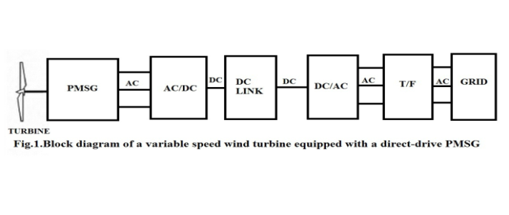
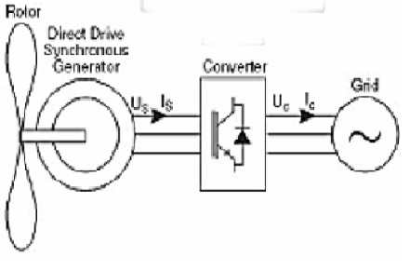
BLOCK DIAGRAM :
Designing of variable speed wind turbine with a permanent synchronous generator without gearbox.

Slide 5


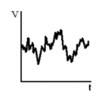
WIND SYSTEM MODEL:
The overall speed of the wind consists of gusting, base noise, ramp and other factors. So the velocity of the wind is given as...
v_{ww}(t)=v_{wb}(t)+v_{wr}(t)+v_{wg}(t)+v_{wn}(t)
Ramp (v_{wr}(t))
Gust (v_{wg}(t))
Random noise (v_{wn}(t))

Slide 6
WIND TURBINE MODEL :
The main equation on which our paper revolves is the power extracted from wind which is given as..
P_{ww}= ½ c_{p} ρAv_{ww}³
Power coefficient (c_{p}) plays key role here, well it is defined as the maximum power that can be extracted from the wind and the maximum value is 0.593 (59.3%)

Slide 7



WIND TURBINE MODEL :
For the calculation of c_{p} the equation employed is..
c_{p}(λ,θ)= c₁ (c₂ - c₃θ - c₄θ^{x} - c₅)
Where,
c₁= 0.4, c₂=116, c₃= 0.4, c₄= 0, c₅= 5, c₆= 21
λ is tip speed ratio

Slide 8
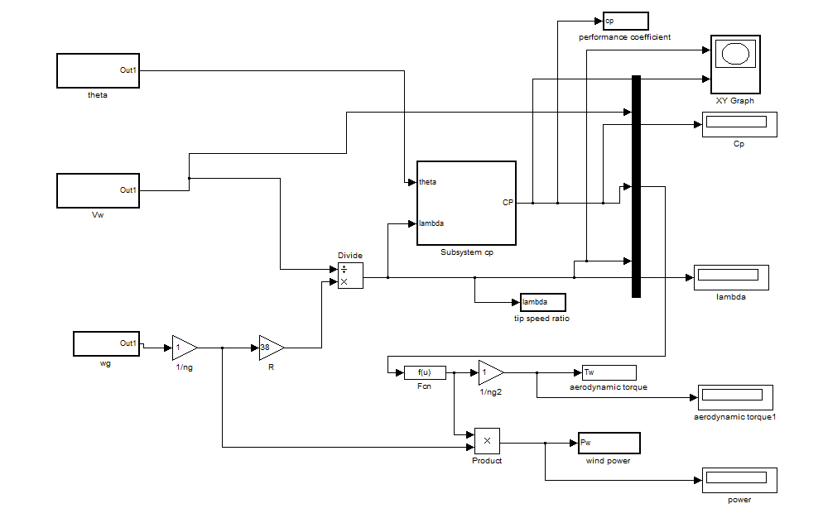

WIND TURBINE MODEL :
c₁= 0.4, c₂=116, c₃= 0.4, c₄= 0, c₅= 5, c₆= 21
Wind Turbine modeled with SIMULINK.

Slide 9
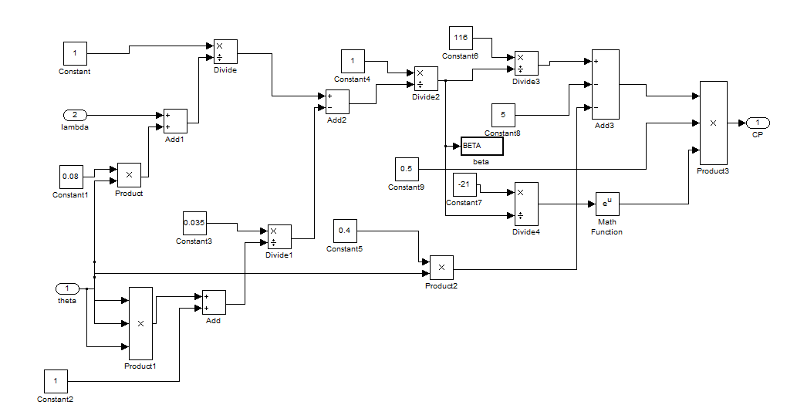
WIND TURBINE MODEL :
c_{p}(λ,θ)= c₁ (c₂ - c₃θ - c₄θ^{x} - c₅)
c₁= 0.4, c₂=116, c₃= 0.4, c₄= 0, c₅= 5, c₆= 21
Subsystem in wind turbine model to calculate Cp value

Slide 10
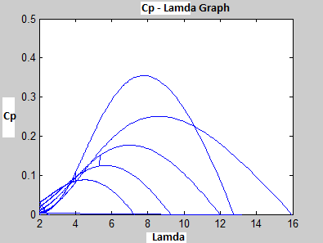
WIND TURBINE MODEL :
Output graph (Cp vs. λ) of wind turbine simulation circuit and wind turbine parameters.

Slide 11
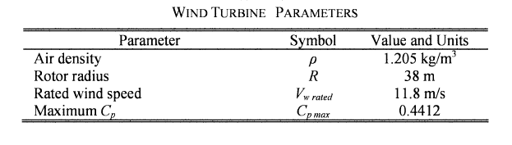
WIND TURBINE MODEL :

Slide 12
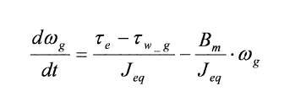

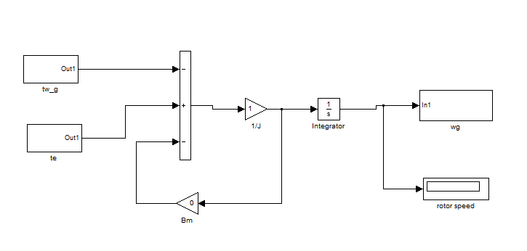
DRIVE TRAIN MODEL:
Drive Train modeled with Simulink.

Slide 13
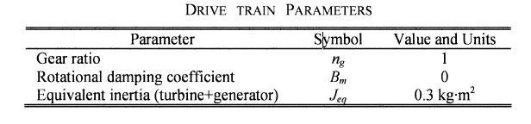
DRIVE TRAIN MODEL:

Slide 14
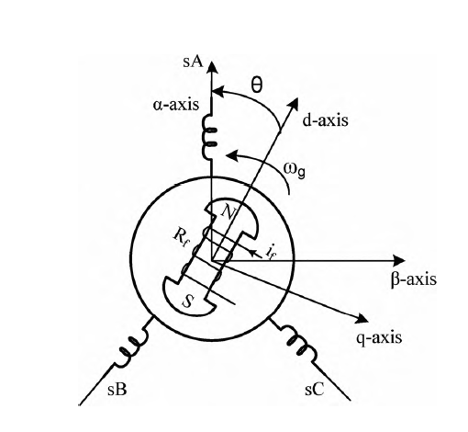
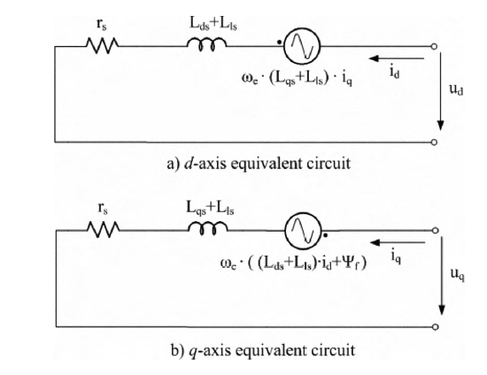
GENERATOR MODEL :
d-q and α- β axis of a typical salient-pole synchronous machine

Slide 15
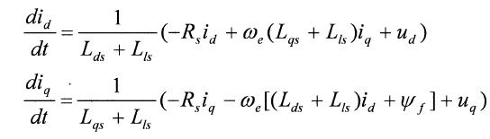

GENERATOR MODEL :
By using these equations we implemented matlab simulation circuit. The equations are as follows..

Slide 16
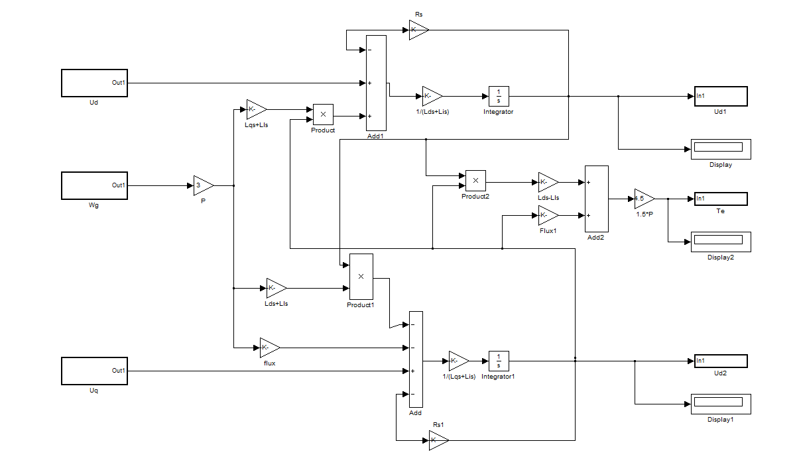
GENERATOR MODEL :
PMSG modeled with Simulink

Slide 17
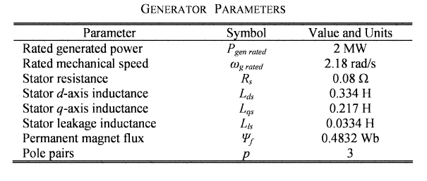
GENERATOR MODEL :
PMSG simulation circuit parameters.

Slide 18
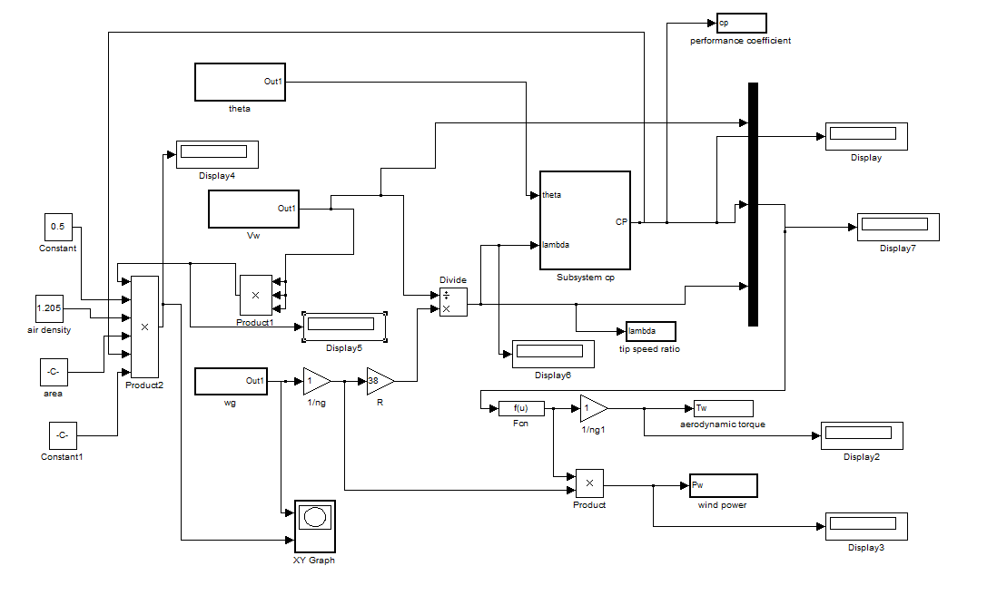
POWER SPEED CHARACTERISTICS SIMULATION CIRCUIT

Slide 19
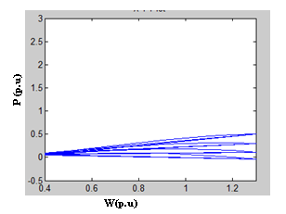
POWER SPEED CHARACTERISTICS SIMULATION CIRCUIT
These are the outcomes of the power speed simulation circuit.

Slide 20
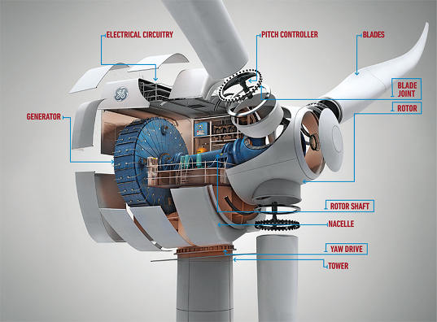
ADVANTAGES:
Do not require D.C supply
No rotor current, hence looses reduces and efficiency increases.
Nacelle weight reduces since no gearbox is adopted.
Future scope

Slide 21
CONCLUSION :
The modeling of a variable speed wind turbine with a permanent magnet synchronous generator has been treated.
The model has been implemented in MATLAB/Simulink in order to validate it. Cp curves have been obtained.
The generator has been modeled in the d-q synchronous rotating reference frame, taking into account different simplifications.
The power speed characteristics are obtained by simulating the circuit.

Slide 22
REFERENCES:
Z. Lubosny. Wind Turbine Operation in Electric Power Systems. Berlin: Springer, 2003.
T. Ackermann. Wind Power in Power Systems. New York: John Wiley & Sons, 2005.
The American Wind Energy Association (2004, March). Global wind power growth continues to strengthen [Online]. Available: http://www.ewea.org.
Horns Rev Offshore Wind Farm Technical Report (2007). Available: http://www.homsrev.dk.
M. Yin, G.Li, M. Zhou and C. Zhao. "Modelling of the wind turbine with permanent magnet synchronous generator for integration". IEEE Power Engineering Society General Meeting, Tampa, Florida, 2007, pp. 1-6.
J. G. Slootweg, S. W. H. de Haan, H. Polinder and W. L. Kling. "General Model for Representing Variable Speed Wind Turbines in Power System Dynamics Simulations". IEEE Transactions on Power Systems, vol. 18, no. 1,2003.

Slide 24



